Slide 1







PROJECTS | PRODUCTS | COURSE | INTERNSHIP
info@discoverprojects.com
www.discoverprojects.com
pro.aiskool@gmail.com
www.aiskool.com
Shop no. 2, Narayan Smurti Building, Opp. Saraswati Book Depot,
Near CIDCO Bus Stop, Thane West, India.
+91 9967478289 / +91 9167769993

Slide 2


Stock Price Prediction
Relevant Image

Slide 3
Introduction and Application
The objective is to build a prediction engine for prediction of stock prices using volume with the help of Linear Regression. When the stock price and volume increase, it shows that some fundamental or psychological factors are driving the stock price. An example of a fundamental factor is earnings news. The expectation of an increase in a stock’s price is an example of a psychological factor. When a stock’s price and volume increase, it indicates the buying interest in the stock. It shows the stock’s uptrend.
When the stock price increases and volume decreases, it indicates traders’ indecision to buy the stock. The indecision arises when there aren’t any fundamental or psychological factors influencing the larger market participants. This means there’s a chance that the trend could change.

Slide 4
Working
FIRST STEP WAS TO COLLECT DATA FROM DIFFERENT SOURCES FOR OUR PROBLEM STATEMENT .
THEN WE HAVE TO CLEAN , PROCESS CATEGORICAL DATA AND NORMALISE IT.
THEN WE SHOW VARIOUS ANALYSIS USING GRAPHS.
SPLIT THE DATA INTO TRAINING AND TEST SET.
SELECT AN ALGORITHM.
FITTING THE MODEL TO TRAINING SET.
SAVING THE MODEL
CHECK ACCURACY OF TRAINED DATA W.R.T TRAIN SET.
TEST THE TRAINED MODEL W.R.T TESTING SET.
CHECK ACCURACY OF TEST DATA W.R.T TEST SET.
BASED ON THE GENERATED GRAPHS AND USING THE ALGORITHM WE PREDICT THE STOCK PRICE.

Slide 5
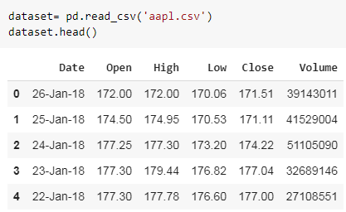
Working and Building
This is the data that we are using in the prediction of the salary. The source of dataset is Kaggle. We have used the read_csv() function of pandas to read the .csv file for dataset and head() function to display the first five lines of dataset.

Slide 6
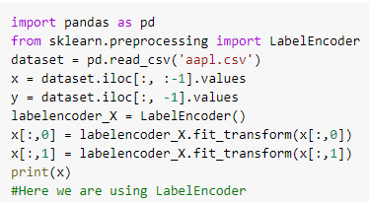
Handling Categorical Data
Label encoding is simply converting each value in a column to a number.

Slide 7
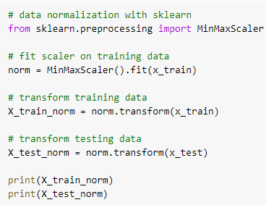
Normalise Data
MinMaxScaler transforms features by scaling each feature to a given range.
fit(self, X[, y]):
Compute the minimum and maximum to be used for later scaling.
transform(self, X):
Scale features of X according to feature_range.

Slide 8
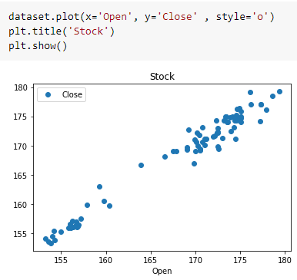
Graphs (1)
Here we have created a simple graph between the opening and closing stock using matplotlib library of Python.
plot():
This function is used to plot a graph between x and y.
show():
This function displays the graph.

Slide 9
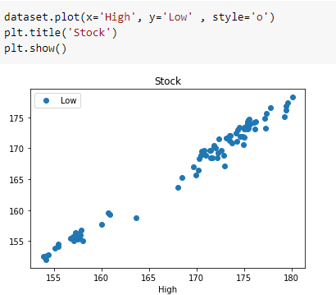
Graphs (2)
Here we have created a simple graph between the high and low price using matplotlib library of Python.
plot():
This function is used to plot a graph between x and y.
show():
This function displays the graph.

Slide 10

Graphs (3)
Here we have created a graph for volume using matplotlib library of Python.
figsize():
width, height in inches.
tight_layout():
automatically adjusts subplot params so that the subplot(s) fits in to the figure area.
seaborn.distplot():
Flexibly plot a univariate distribution of observations.

Slide 11
Splitting Data
Python has a library sklearn which contains a function ‘train_test_split’. This function is used to Split arrays or matrices into random train and test subsets.
test_size float or int, default=None:
If float, should be between 0.0 and 1.0 and represent the proportion of the dataset to include in the test split. If int, represents the absolute number of test samples. If None, the value is set to the complement of the train size. If train_size is also None, it will be set to 0.25.
random_state int or RandomState instance, default=None
Controls the shuffling applied to the data before applying the split. Pass an int for reproducible output across multiple function calls.

Slide 12

Selecting Algorithm
The algorithm that we have used is Linear Regression.
LinearRegression() fits a linear model with coefficients w = (w1, …, wp) to minimize the residual sum of squares between the observed targets in the dataset, and the targets predicted by the linear approximation.
model is the object for LinearRegression().

Slide 13

Fitting the model to trained dataset
We have used the fit() function to fit our model to the training dataset and hence passed the parameters for the same.

Slide 14
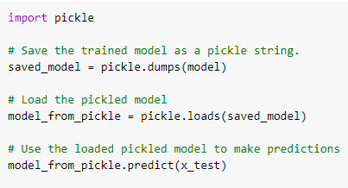
Saving the model
We can use the Pickle library in Python to save our model. In this code we can see that the model has been saved as a string.
So, first we save the model as a string, then we load it and use it to make predictions.

Slide 15
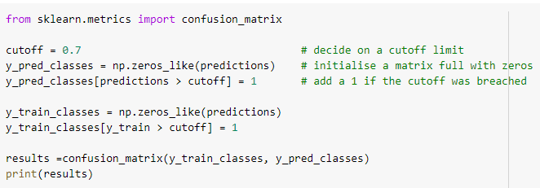
Confusion Matrix
Confusion Matrix function is present in the sklearn library of Python. A confusion matrix is a table that is often used to describe the performance of a classification model (or “classifier”) on a set of test data for which the true values are known. It allows the visualization of the performance of an algorithm.
In this code we have used a cut-off. This is because we have converted all the values in the dataset into binary by using the zeroes_like() function so that no error because of continuous data occurs.

Slide 16
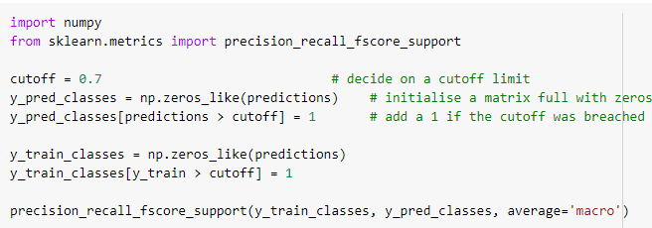
Precision, Recall, Support, Fscore
The precision is intuitively the ability of the classifier not to label as positive a sample that is negative. The recall is intuitively the ability of the classifier to find all the positive samples.The F-beta score can be interpreted as a weighted harmonic mean of the precision and recall, where an F-beta score reaches its best value at 1 and worst score at 0.The support is the number of occurrences of each class in y_true. We have used the precision_recall_fscore_support() function for the same. And, again we have used the cut-off values for converting the array into binary.
**In the same way we will calculate the confusion matrix, precision, recall, support and fscore for the test dataset.**

Slide 17
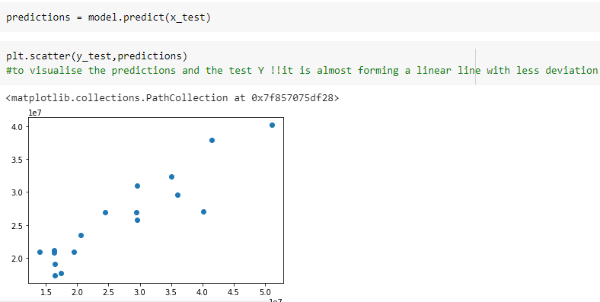
Prediction
We have used the predict() function for making the predictions on our model. Also. scatter() method is used to plot the graph for our predictions.

Slide 18
Evaluate, Tune and Improve Neural Network
In this code we have used the MSE, MAE and RMSE method for evaluation.
Mean Absolute Error: We know that an error basically is the absolute difference between the actual or true values and the values that are predicted.
Mean Square Error: MSE is calculated by taking the average of the square of the difference between the original and predicted values of the data.
Root Mean Square Error: RMSE is the standard deviation of the errors which occur when a prediction is made on a dataset. This is the same as MSE (Mean Squared Error) but the root of the value is considered while determining the accuracy of the model.

Slide 19
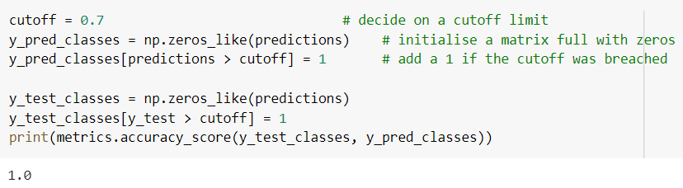
Calculating Efficiency:
Accuracy is the most intuitive performance measure and it is simply a ratio of correctly predicted observation to the total observations. One may think that, if we have high accuracy then our model is best. Yes, accuracy is a great measure but only when you have symmetric datasets where values of false positive and false negatives are almost same. Therefore, you have to look at other parameters to evaluate the performance of your model.
Accuracy = TP+TN/TP+FP+FN+TN

Slide 20
FAQ
What is the use of read_csv()?
read_csv() is an important pandas function to read csv files and do operations on it.
What is the use of iloc?
iloc returns a Pandas Series when one row is selected, and a Pandas DataFrame when multiple rows are selected, or if any column in full is selected. To counter this, pass a single-valued list if you require DataFrame output.
What is Linear Regression and when is it used?
Linear regression models are used to show or predict the relationship between two variables or factors. The factor that is being predicted (the factor that the equation solves for) is called the dependent variable. The factors that are used to predict the value of the dependent variable are called the independent variables. It is used when we want to predict the value of a variable based on the value of another variable.

Slide 21
FAQ
4. What is the difference between the RMSE and RMSLE method for measuring accuracy?
The value of the RMSE explodes in magnitude as soon as it encounters an outlier. In contrast, even on the introduction of the outlier, the RMSLE error is not affected much i.e. RMSLE is very robust when outliers come into play.
5. Can we use RMSLE method for measuring accuracy?
Yes, we can.
6. How can we control the variables in Linear Regression?
This model isolates the role of each variable while holding the other variable constant.

